Slide 1
Language make Personality

Slide 2
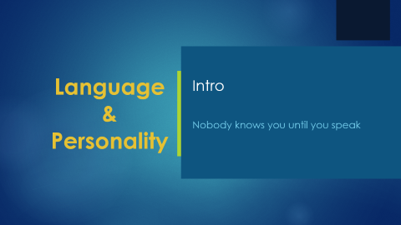
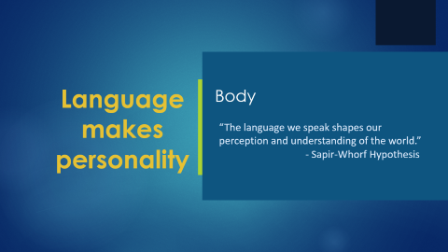
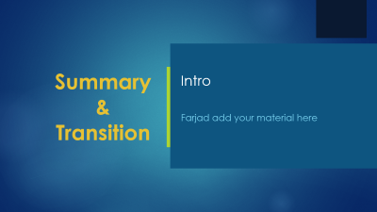
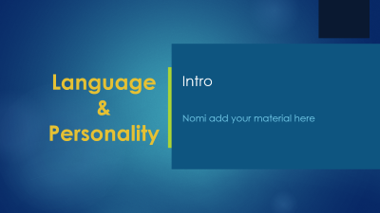
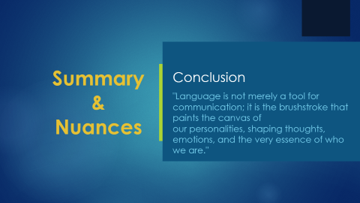
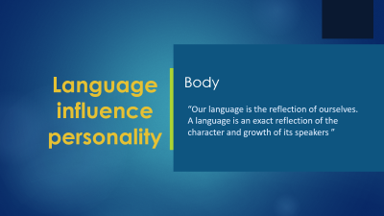
Presentation Flow
Into
Body
Conclusion
Numan Ahmad
2021-SE-24
Wali Muhammad
2021-SE-39
Farjad Waseem
2021-SE-56

Slide 3
Language & Personality
Intro
Nobody knows you until you speak

Slide 4
Language and personality
Language is the medium of communication to convey thoughts, ideas to others.
Personality is a mixture of our behaviors, thoughts and emotions – a unique blueprint that defines our adjustment to life’s complexities

Slide 5
How Language influences personality
The language we use.
The words we choose
Our tone during communication
Our nuances in our expressions

Slide 6
Language makes personality
Body
“The language we speak shapes our perception and understanding of the world.”
- Sapir-Whorf Hypothesis

Slide 7
Linguistic Characteristic
Language as a Constructive Force
  What you feel is what you speak
  Your tone and choice or words matters

Slide 8
Language and Perception
People speaking different language poses different personalities
Strong language makes strong personality

Slide 9
Summary
&
Nuances
Conclusion
"Language is not merely a tool for communication; it is the brushstroke that paints the canvas of
our personalities, shaping thoughts, emotions, and the very essence of who we are."

Slide 10
Language relates personality
Influence of Language
Effectiveness of Fluent Language
Internationally Recognized

Slide 11
Language affecting personality
Influence of Culture
Power Dynamics in Language
Self-Perception
Pronunciation, accent, and tone.

Slide 12
Thanks for listening!

